Slide 1
Vehicle trajectory prediction by drone videos

Slide 2
cheatsheet
Describe how things should work.
Explain the problem and state why it matters.
Explain your problem's financial costs.
Back up your claims.
Propose a solution.
Explain the benefits of your proposed solution(s).
Conclude by summarizing the problem and solution

Slide 3
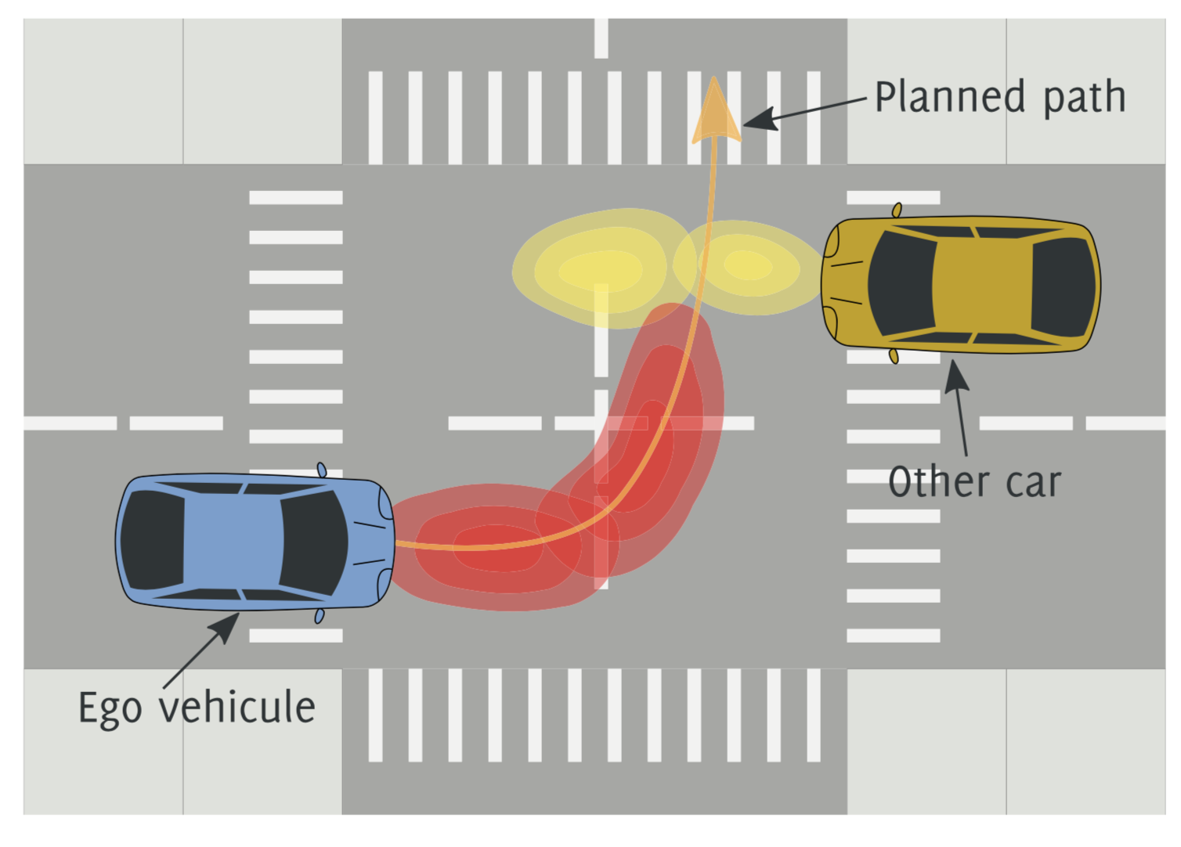
motivation
Predict trajectory is important:
Recent years, UAV has been widely used. [examples in road safety analysis…]
Research efforts in trajectory pred using UAV lack
Why UAV challenging:
Multi objects,
Research Gaps: investigate how UAV could be utilized in trajectory pred

Slide 4
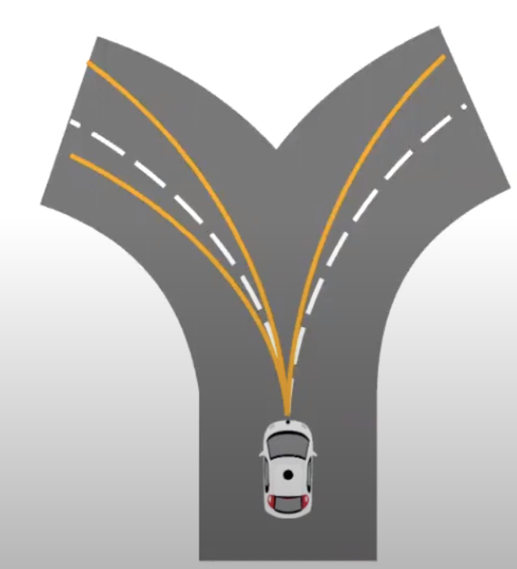
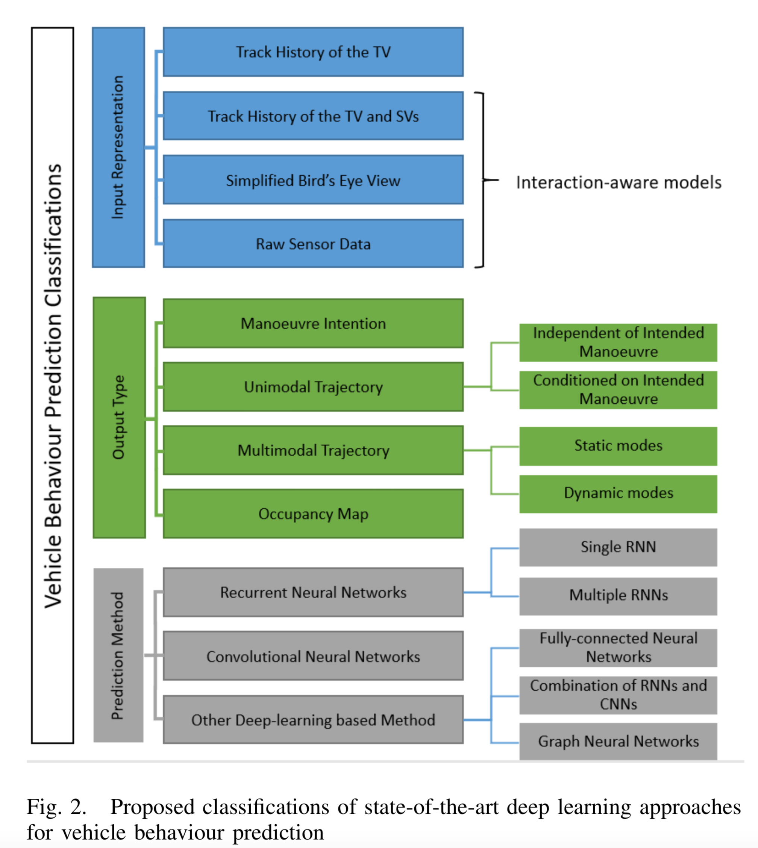
Overview
Trajectory prediction methods:
Challenges of prediction: high uncertainty
UAV videos:

Slide 5
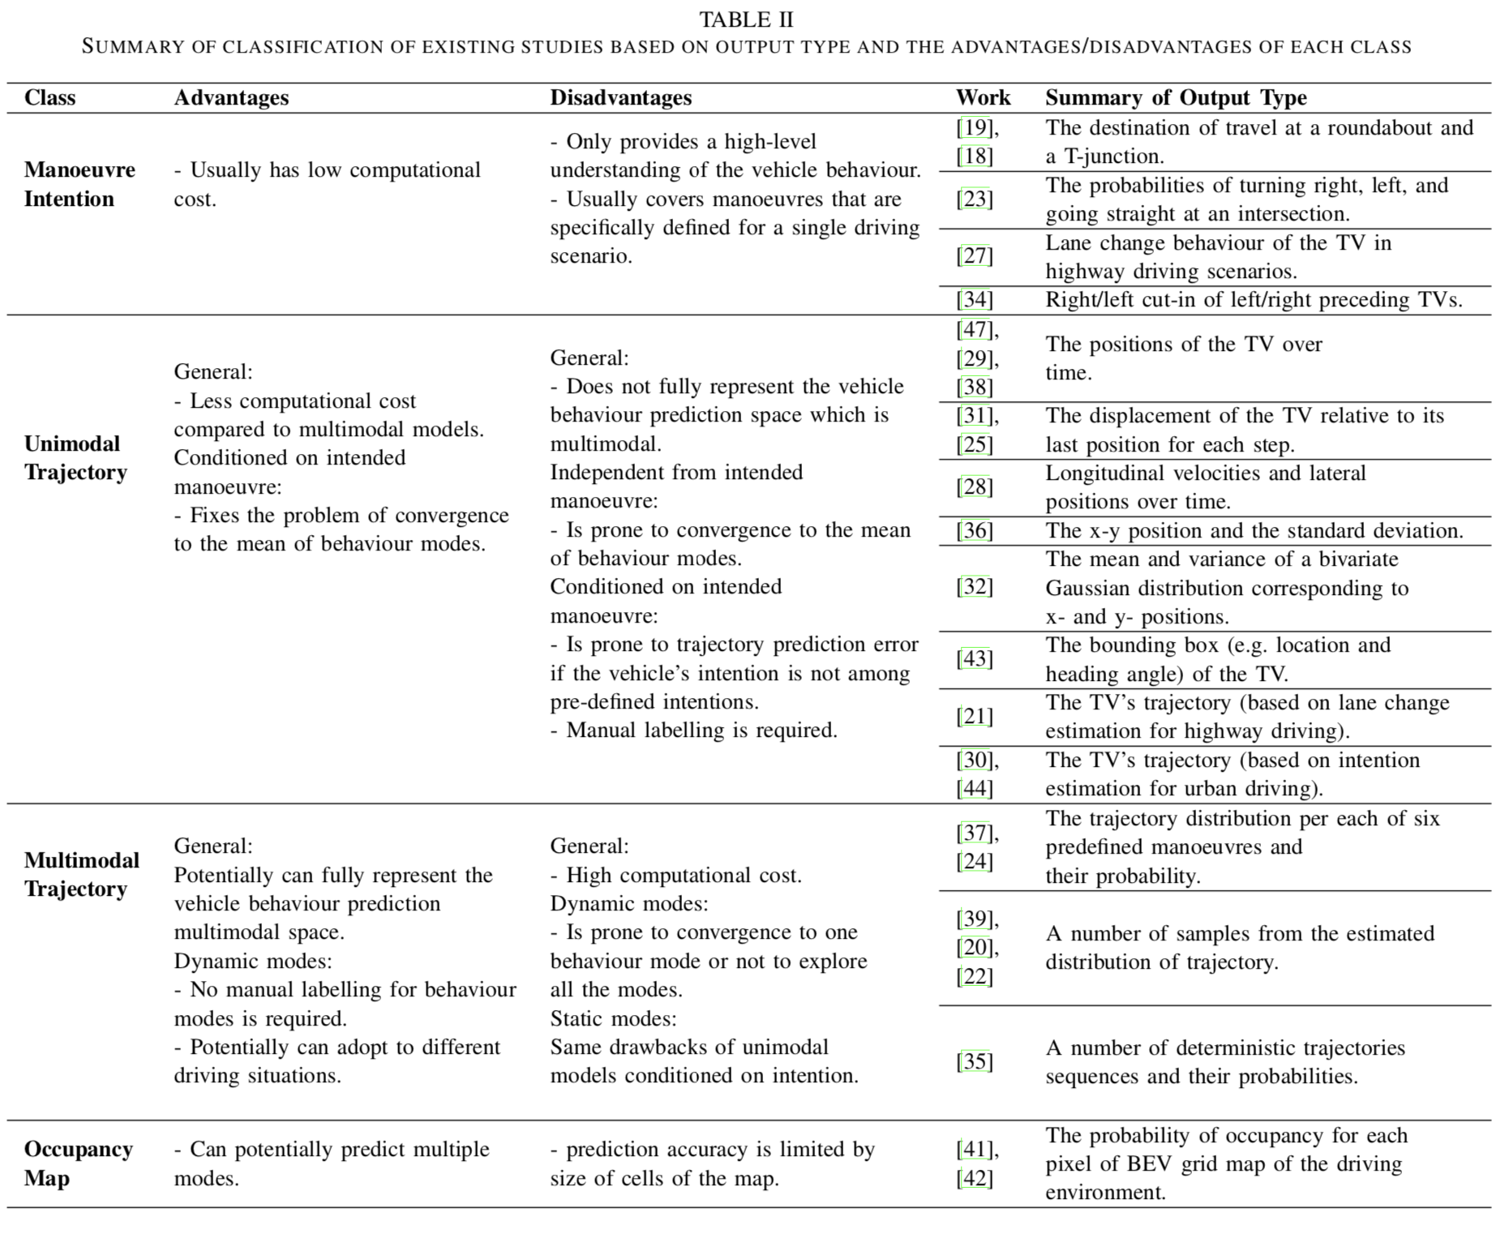
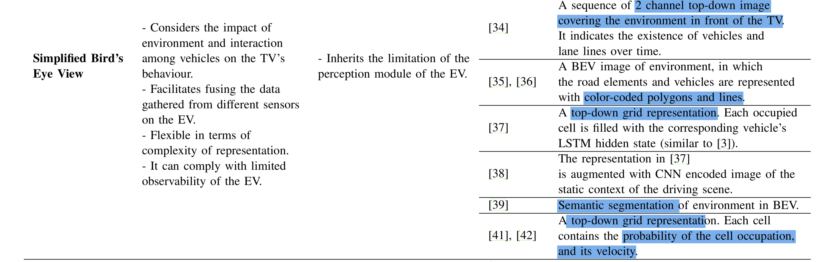

Slide 6
objective
Develop model
Justify

Slide 7
method

Slide 8
Potential impacts
Model
improve MOT
Illustrate adv of UAV application
Also look at what others say in other UAV transportation papers

